Slide 1
Lesson 1:
Introduction to C++
By: Ryan Alterman
ralterman99@gmail.com
Revised: 8-10-17

Slide 2
What is C++?
Object oriented language
Statically typed
Checks syntax during compile, not run-time
Considered a moderately difficult language to learn
Tips:
Don’t focus on the technical terms
Focus on how it works and why
Learn how syntax works

Slide 3
Classes, objects, methods, and Instance variables.
There are four main parts to basic syntax
Objects
Have properties and Behaviors
Class
A template that describes behaviors and states of objects
Methods
They are the functions that a class can call
They are contained within classes
Instance Variables
These define the state of variables, which makes them temporary

Slide 4
Semicolons, Blocks, and Parentheses
Semicolons(;)
They are statement terminators
In order to end a statement, you MUST put a semicolon
WARNING: if you forget to put a semicolon, the compiler will not know when the statement has ended. Which can cause problems all over the place.
Blocks({ })
This is an organizational tool in C++, as well as necessary
They are called using opening brackets({) and closing brackets(})
They always come in pairs
Parentheses()
These are used to set the parameters of functions
More on functions later

Slide 5
Commenting Code
It is always important to make sure you leave comments in your code
It helps you:
If you forget what something was
If it works only a certain way
It helps others:
Understand the code
Help edit the code
How to leave comments
SIngle Line Comments
/* insert comment here*/
Multiline Comments
/* comment * spans multiple */ lines

Slide 6
Whitespace
The space in between every element of C++
It does not matter
The compiler completely ignores whitespace
This means that it is used to separate elements
And organize code
Also more of a styling thing

Slide 7
Identifiers and Keywords
Identifiers
Fancy way of saying name
They are the name given to user defined objects
Variables
Functions
Classes
Namespaces
Constants
Etc.
Important: Identifiers can not be keywords
Keywords
Reserved words in the C++ language
These are words included in the libraries.
They are:
Methods
Some namespaces
Some classes

Slide 8
Challenge
I want you to make a simple Hello World Program

Slide 9
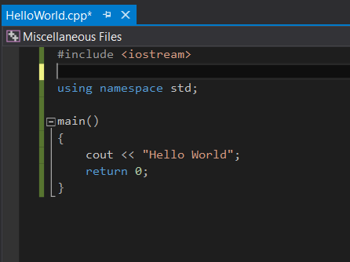
Hello World

Slide 10
Next: Variables and Scope

